Slide 1
Uva 11297
Census
Time: 8 seconds

Slide 2
Problem Descriptions
This year, there have been many problems with population calculations, since in some cities, there are many emigrants, or the population growth is very high. Every year the ACM (for Association for Counting Members) conducts a census in each region.
The country is divided into N^2 regions, consisting of an N × N grid of regions. Your task is to find the least, and the greatest population in some set of regions. Since in a single year there is no significant change in the populations, the ACM modifies the population counts by some number of inhabitants.

Slide 3
Input
In the first line you will find N (0 ≤ N ≤ 500)
In following the N lines, you will be given N numbers which represent the initial population of city C[i, j].
In the following line is the number Q (Q ≤ 40000), followed by Q lines with queries:
There are two possible queries:
‘q x₁ y₁ x₂ y₂’ which represents the coordinates of the upper left and lower right of where you must calculate the maximum and minimum change in population.
‘c x y v’ indicates a change of the population of city C[x, y] by value v.

Slide 4
Output
For each query, ‘q x1 y1 x2 y2’ print in a single line the greatest and least amount of current population.
Separated each output by a space.
Notice: There is only a single test case.

Slide 5

Sample I/O
 | 1 | 2 | 3 | 4 | 5
1 | 1 | 2 | 3 | 4 | 5
2 | 0 | 9 | 2 | 1 | 3
3 | 0 | 2 | 3 | 4 | 1
4 | 0 | 1 | 2 | 4 | 5
5 | 8 | 5 | 3 | 1 | 4
5x5 grids
5
1 2 3 4 5
0 9 2 1 3
0 2 3 4 1
0 1 2 4 5
8 5 3 1 4
4
q 1 1 2 3
c 2 3 10
q 1 1 5 5
q 1 2 2 2
9 0
10 0
9 2
Population
Initialization
 | 1 | 2 | 3 | 4 | 5
1 | 1 | 2 | 3 | 4 | 5
2 | 0 | 9 | 10 | 1 | 3
3 | 0 | 2 | 3 | 4 | 1
4 | 0 | 1 | 2 | 4 | 5
5 | 8 | 5 | 3 | 1 | 4
4 operations
 | 1 | 2 | 3 | 4 | 5
1 | 1 | 2 | 3 | 4 | 5
2 | 0 | 9 | 10 | 1 | 3
3 | 0 | 2 | 3 | 4 | 1
4 | 0 | 1 | 2 | 4 | 5
5 | 8 | 5 | 3 | 1 | 4

Slide 6
2D Segment Tree
[x1, y1] [x2, y2]=[2, 4] [5, 6]
[0,7]
[x1, x2]=[2, 5]=[2,3]+[4,5]
[y1, y2]=[4, 6]=[4,5]+[6,6]
[0,7]
[0,3]
[4,7]
[0,3]
[4,7]
[0,1]
[2,3]
[4,5]
[6,7]
[0,1]
[2,3]
[4,5]
[6,7]
[6,6]
[0,7]
[y1, y2]=[4, 6]=[4,5]+[6,6]
[0,3]
[4,7]
[0,1]
[2,3]
[4,5]
[6,7]
[6,6]

Slide 7
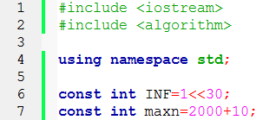
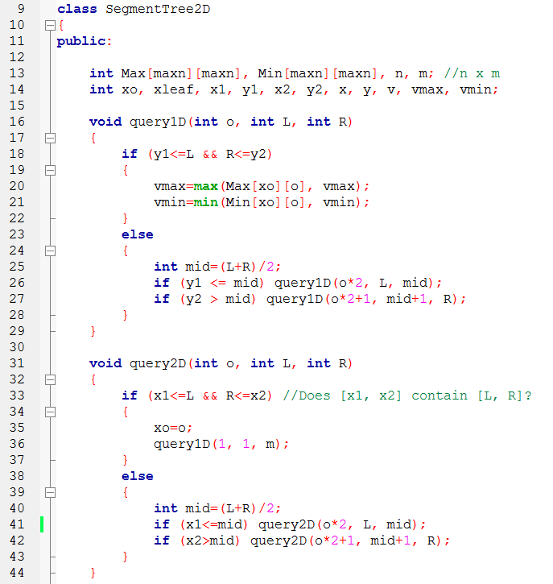
Query
query
(x1, y1, x2, y2)
(x1, y1)
(x2, y2)
錯誤改正

Slide 8
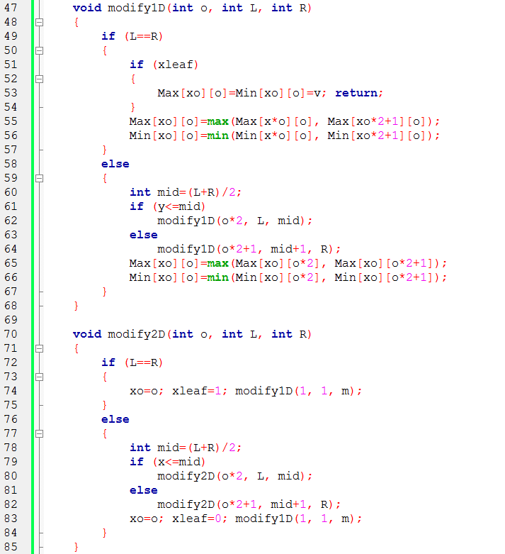
Modify
modify
(x1, y1, v)

Slide 9
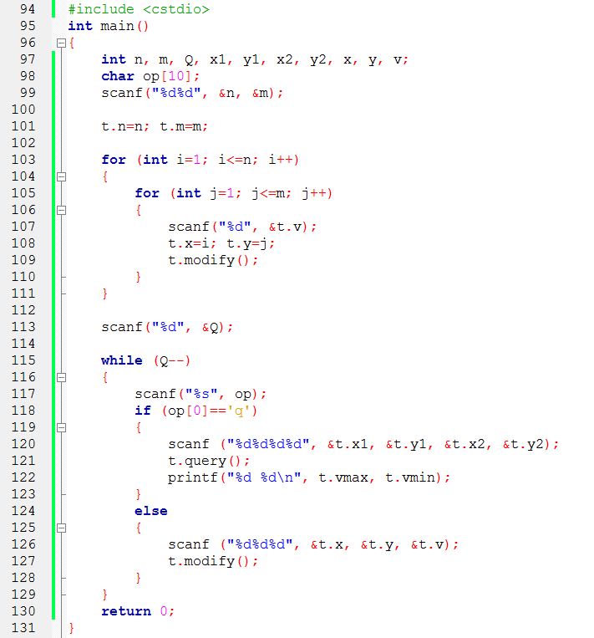
main( )

